Slide 1
FILM GAME PROJECT
Film Guessing Game
An Interactive JavaFX Desktop Application
JavaFX + MySQL
Client-Server Architecture
INTERACTIVE DESKTOP APPLICATION

Slide 2
CONTENTS
| Overview
01
02
03
04
Project
Overview
System
Architecture
Core
Implementation
Deployment
& Future
Game features and design
Client-server design patterns
Setup guide and enhancements
Technology stack and components

Slide 3
FILM GUESSING GAME
PART 01
01
Project Overview
Understanding the game's core features

Slide 4
KEY FEATURES & OVERVIEW
PART 01
Project Overview
Interactive UI
Film Guessing Core
Database & Scoring
Built with JavaFX to deliver a smooth and engaging visual experience for players. The interface features intuitive navigation and responsive design.
Players predict film names from provided actor clues. The central guessing mechanic challenges cinema knowledge with progressive difficulty.
MySQL integration manages film data, player progress, and in-game economy. Features a scoring mechanism with coins and defined level progression.

Slide 5
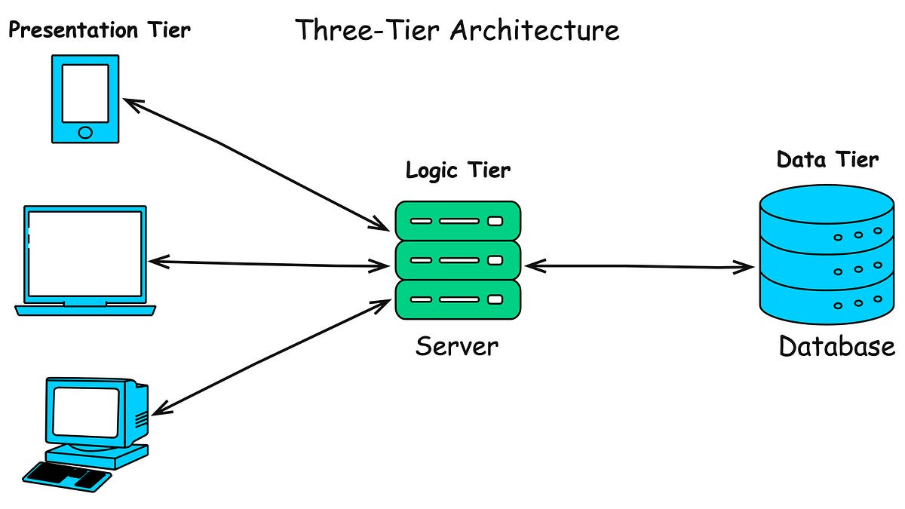
SYSTEM ARCHITECTURE OVERVIEW
PART 01
Architecture Design
Three-Tier Design
The application adopts a client-server architectural principle. The JavaFX application serves as the client front-end, while MySQL acts as the data backend. A REST/JDBC communication layer bridges the two tiers, enabling seamless data exchange.
This separation ensures maintainability, scalability, and clean separation of concerns between presentation and data layers.

Slide 6
FILM GUESSING GAME
PART 02
02
System Architecture
Client-server design and data flow

Slide 7
CLIENT-SERVER MODEL
PART 02
Architecture Detail
JavaFX Client
REST / JDBC Layer
MySQL Server
Handles the user interface and request logic. Built with JavaFX for responsive and interactive desktop experience.
Bridges client and server using JDBC driver. Manages connection strings, query execution, and result handling.
Persistent storage and connection handling. Stores film data, player progress, and game state.
Data Flow: SELECT, INSERT, UPDATE, DELETE | Authentication & Access Control
The client-server model ensures clean separation of concerns. The JavaFX client handles all presentation logic while MySQL manages data persistence. All database operations flow through the JDBC layer with proper credential-based access control.

Slide 8
PROJECT STRUCTURE
PART 02
Code Organization
Package Structure
01
FilmGame Package
Contains the core JavaFX UI components and primary game logic. Includes Main.java, MainFrame.java, LevelsFrame.java, PlayFrame.java, and MusicAndSound.java.
02
database Package
Dedicated package for all MySQL database interaction methods and connection management. Includes DataBaseConnection.java for JDBC connectivity.
03
Resources
The images folder stores graphical assets for the UI, while the sound folder contains audio files for background music and in-game sound effects.

Slide 9
FILM GUESSING GAME
PART 03
03
Implementation
Technology stack and core components

Slide 10
CORE TECHNOLOGY STACK
PART 03
Technology Foundation
JavaFX
MySQL
Java
Dedicated framework for responsive and interactive User Interface development. Provides rich UI controls, CSS styling, and FXML support for building modern desktop applications.
Relational Database Management System for efficient and structured data persistence. Stores film data, player progress, scores, and game state reliably.
The core programming language governing all application logic and functionality. Platform-independent, object-oriented, with robust library support.

Slide 11
JAVAFX UI COMPONENTS
PART 03
User Interface Classes
Core Classes
01
Main.java
Application entry point extending javafx.application.Application. Initializes and launches the primary interface (MainFrame).
02
MainFrame.java
Serves as the initial screen or main menu, handling application flow and navigation between different game screens.
03
LevelsFrame.java
Manages the display and selection of available game levels, showing player progress and unlocked stages.
04
PlayFrame.java
The central game screen where users actively interact with the film guessing mechanism, input answers, and utilise hints.

Slide 12
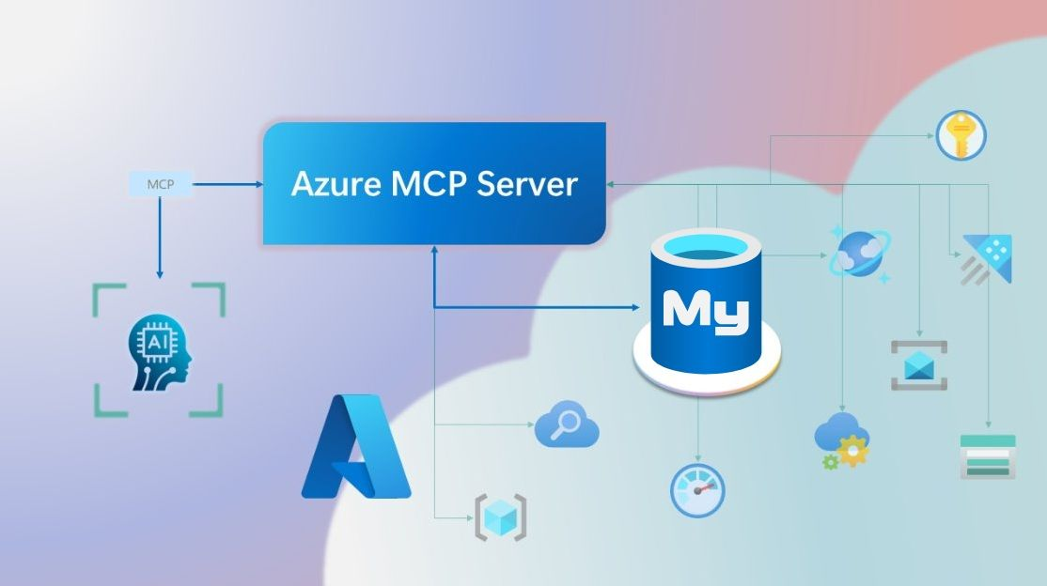
DATABASE INTEGRATION
PART 03
Data Persistence Layer
ManageDataBase Package
The database package contains crucial classes that abstract data persistence complexity. DataBaseConnection.java establishes the MySQL connection using the JDBC driver with the connection string for localhost access.
Key Database Tables
film_actors - Film titles and actor names
game_state - Player progress tracking
coins - In-game economy and scoring system

Slide 13
FILM GUESSING GAME
PART 04
04
Deployment & Future
Setup instructions and planned enhancements

Slide 14
SETUP & INSTALLATION
PART 04
Getting Started
Prerequisites
JDK 8+ installed | MySQL Server running instance | MySQL JDBC Driver (Connector/J) in classpath
01
Clone Repository
Clone the project from GitHub repository. Ensure you have Git installed and configured on your development machine.
02
Create Database
Create the MySQL database named "films". Define the necessary tables including film_actors, game_state, and coins with proper schema.
03
Configure & Run
Populate film_actors table with data, update the database connection string in DataBaseConnection.java with your credentials, then build and run using a Java IDE.

Slide 15
FUTURE ENHANCEMENTS
PART 04
Roadmap Ahead
Advanced Hints System
Sophisticated Scoring
Multiplayer Support
Implementing more sophisticated and contextual hints beyond simple actor names to aid players. Genre tags, release year clues, and director hints.
Introducing detailed scoring mechanisms, score multipliers based on difficulty, time bonuses, and leaderboards for competitive play.
Integrating online functionality to allow multiple users to play simultaneously or compete head-to-head in real-time film guessing battles.
Building on a solid foundation for expanded game complexity and user interaction
These enhancements represent the natural evolution of the Film Guessing Game. The modular architecture and clean codebase make these features straightforward to implement, ensuring the game can grow with its player community.

Slide 16
THANK YOU FOR LISTENING
Film Guessing Game
JavaFX + MySQL Project
Questions Welcome
INTERACTIVE | DESKTOP | GAME
Film Guessing Game Project

